Slide 1
What’s New?

Slide 3
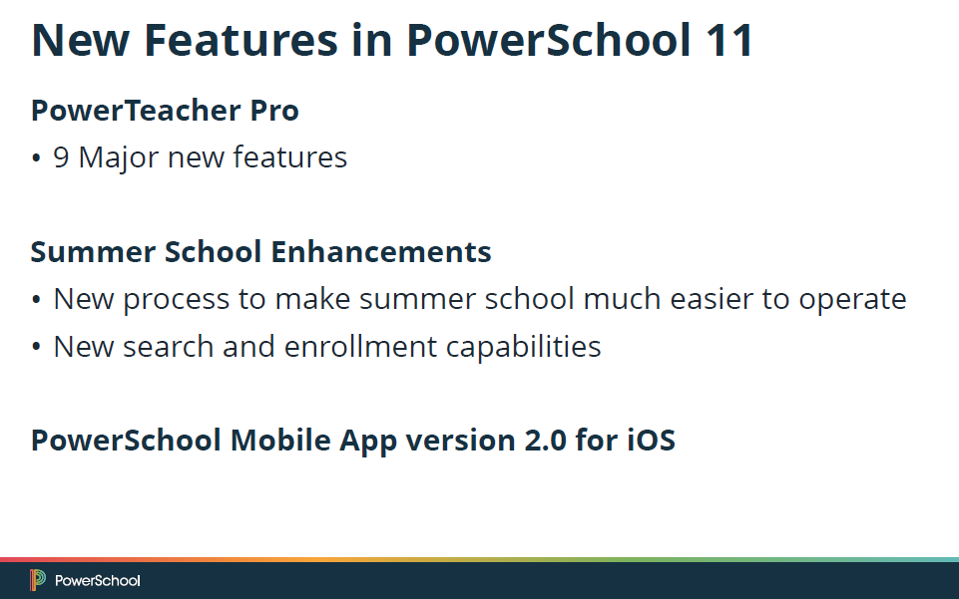
Remote Enrollments/Summer School Enhancements

Slide 4

Online Help now includes State Reporting Information
Resolved Issues
Unknown Error no longer appears in the Mobile App if there is more than one fee balance record for a single year
Any blank final traditional or standards grades at the end of the term will no longer be marked as a Manual Override

Slide 12
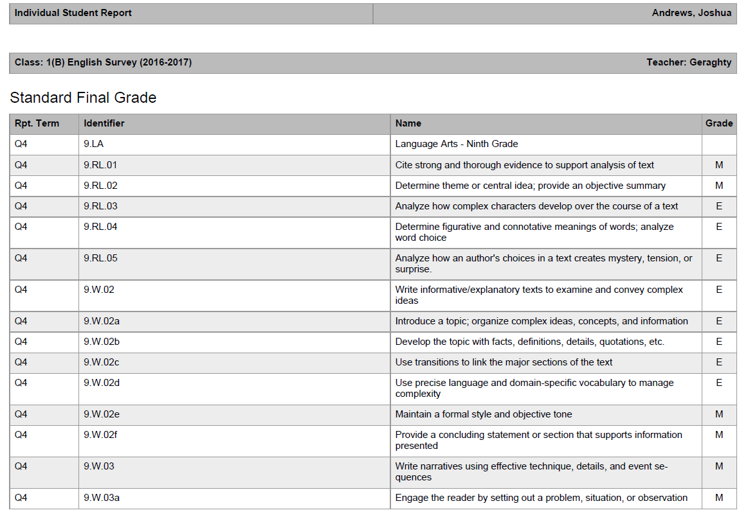

Slide 33
Remote/Summer School
Enrollments
Remote/Summer School Enrollments

Slide 34
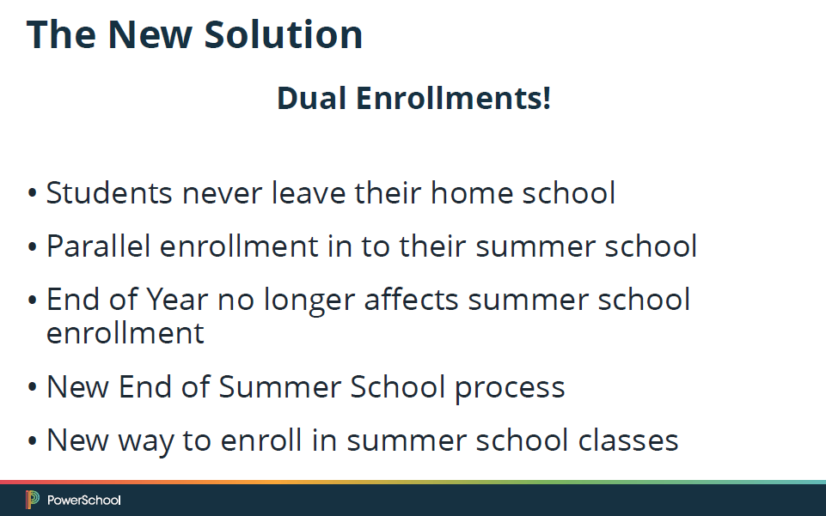
Remote/Summer School Enrollments

